Slide 1

Experiential Learning Project Assessment-I on
“ English to Hindi Transister”
under the course
Python Programming Language (N-PCCCM304P)
Presented By
Krutika N. Dhawale
Under the Guidance of
Mrs. Mayuri Getme
Session:2026-27 (ODD )
Department of CSE(AI&ML)
S. B. JAIN INSTITUTE OF TECHNOLOGY MANAGEMENT AND
RESEARCH,NAGPUR
An Autonomous Institute, Affiliated to RTMNU, Nagpur
)

Slide 2
Introduction
English to Hindi Translator is a Python-based project.
It converts English words and sentences into Hindi.
It uses an English-Hindi dictionary for translation.
The project uses basic Python concepts like strings, dictionaries, functions, loops, and conditions.
It helps users understand the basic concept of language translation.
It is simple, easy to use, and suitable for beginners.
S. B. Jain Institute of Technology Management and research

Slide 3
Objectives
Objectives
To create a simple English to Hindi translator using Python.
To accept English text from the user.
To translate English words into Hindi.
To use a dictionary for storing English-Hindi words.
To use functions to make the program easy to understand.
To handle words that are not available in the dictionary.
To display the final Hindi translation.
To develop a simple English to Hindi Translator using Python.
To translate English words and sentences into Hindi.
To understand the use of Python dictionaries for storing translations.
To apply basic Python concepts such as functions, loops, strings, and conditions.
To make the translation process simple and user-friendly.
To provide a basic foundation for developing advanced translation systems.

Slide 4
Algorithm
Start the program.
Create an English-Hindi dictionary.
Take English text as input from the user.
Split the text into individual words.
Check each word in the dictionary.
Replace the English word with its Hindi meaning.
Join all translated words to form the sentence.
Display the Hindi translation.
Stop the program

Slide 5
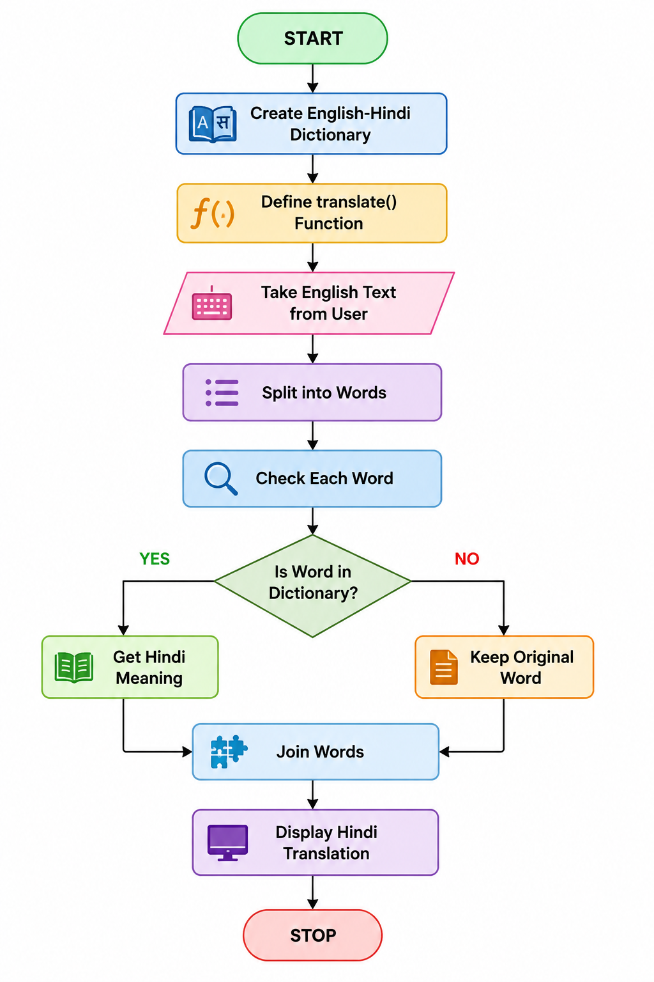
Flowchart

Slide 6
PHASE-II
Objectives
To create a larger dictionary with more English words and their Hindi meanings.
To process the sentence properly by converting it to lowercase and removing punctuation.
To translate words one by one using loops and dictionary checking.
To handle unknown words and errors and display the complete Hindi translation correctly.

Slide 7
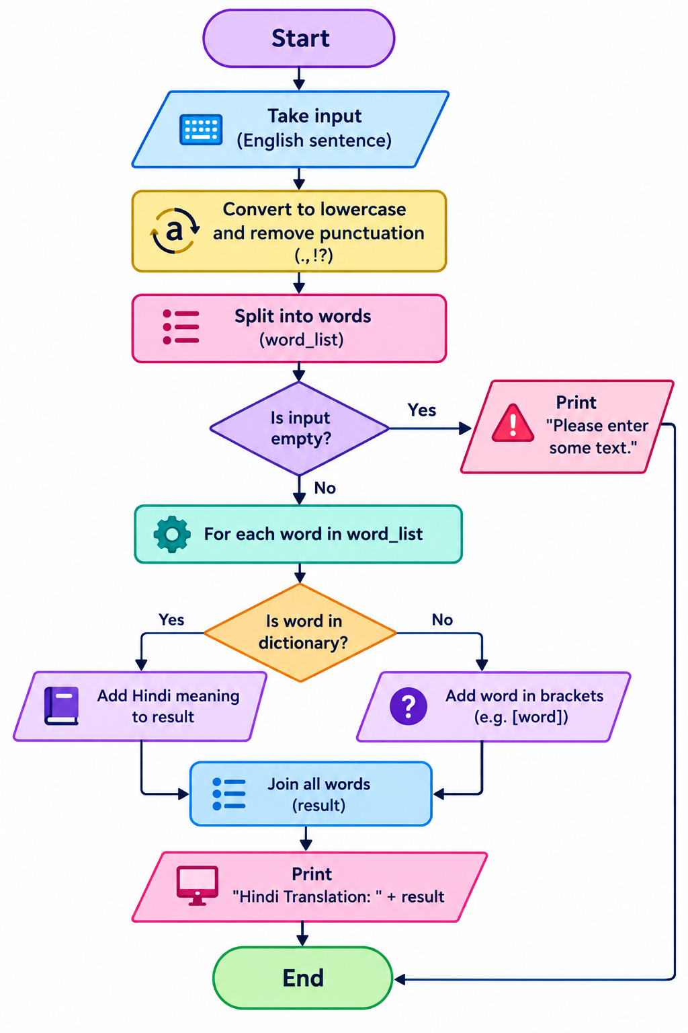
Flowchart

Slide 8
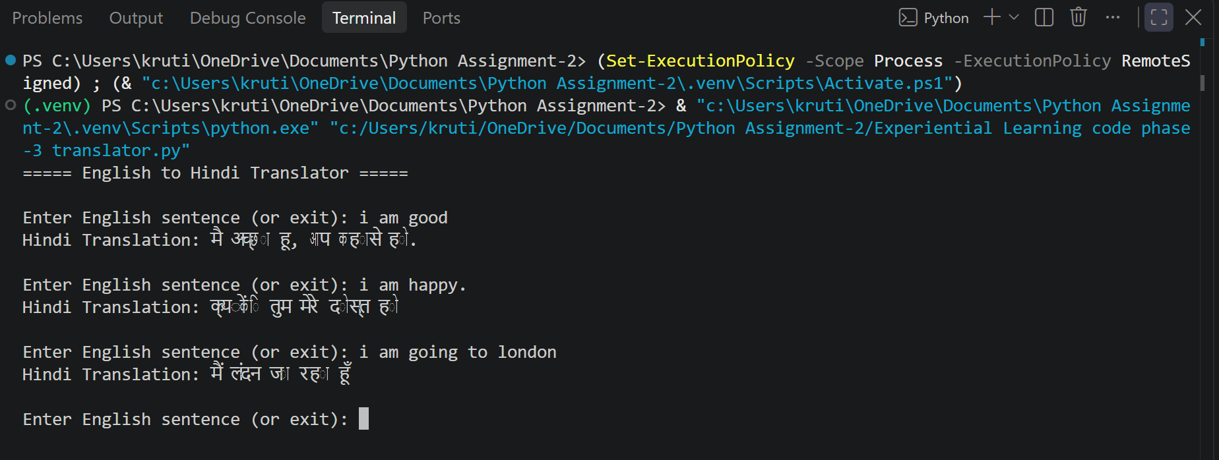
Output Phase-III

Slide 9
PHASE-III
Objectives
To develop a Python program that translates English sentences into Hindi.
To accept complete sentences as input from the user.
To use an online translation service to convert English text into Hindi.
To handle empty input and translation errors.
To allow users to translate multiple sentences until they enter exit.

Slide 10
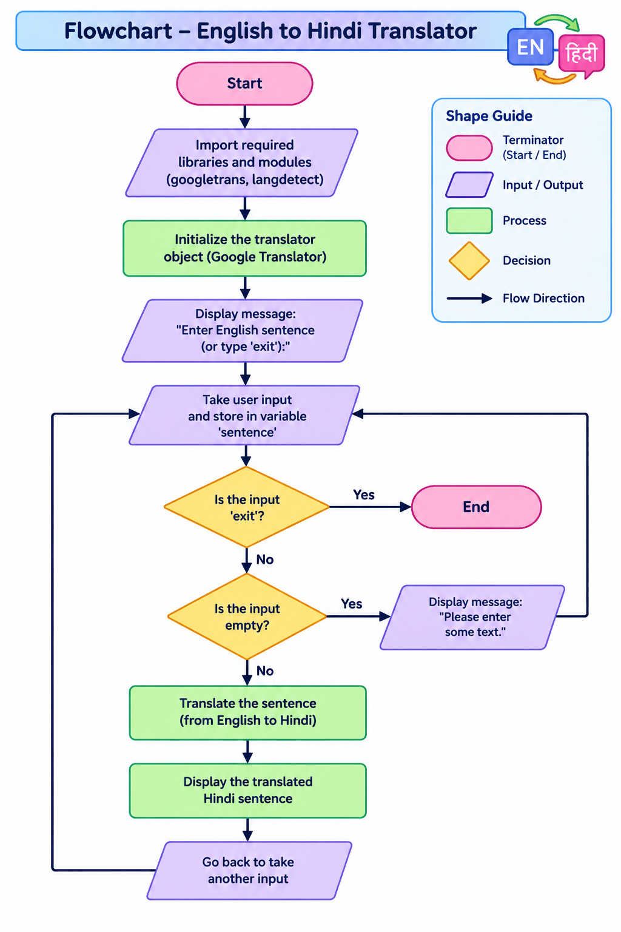

Slide 11
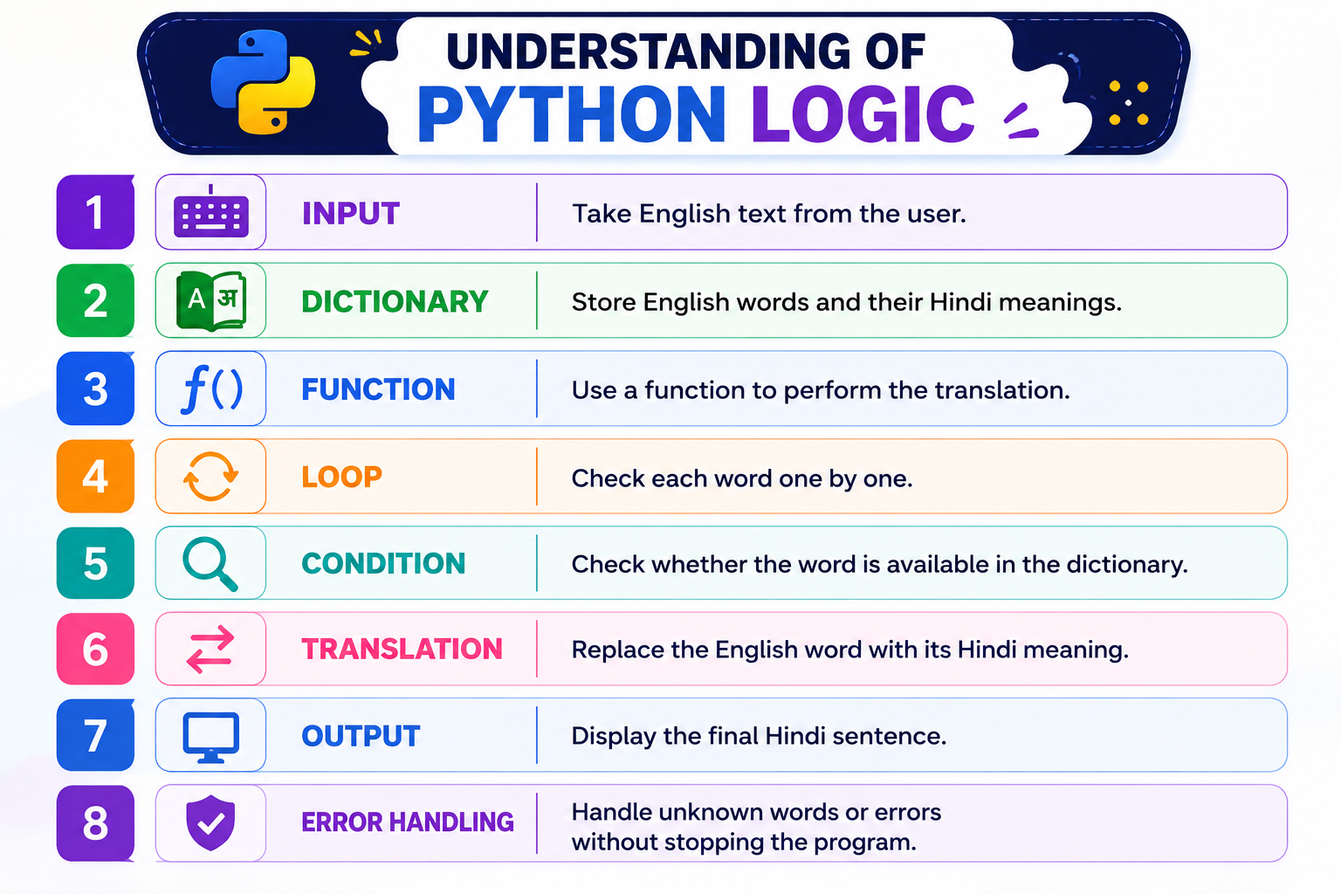


Slide 12
GitHub Understanding
GitHub Account: Create and maintain a GitHub account.
Repository Creation: Create a repository for the project.
Uploading Code: Upload Python source code to the repository.
Meaningful Commits: Save changes with clear commit messages.
Collaboration: Share and work on the project with team members.
Individual Contribution: Contribute code, documentation, testing, or improvements individually.

Slide 13
Thank You
S. B. Jain Institute of Technology Management and research

